Slide 1
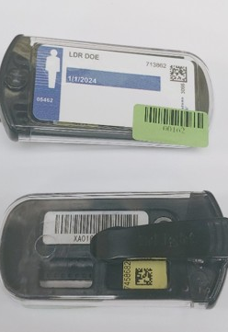

The U.S Department of Energy
Laboratory Accreditation Program &
The Performance Testing Laboratory
Celena Lewis
Radiological and Environmental Sciences Laboratory

Slide 2

Testing Laboratory
Performance Reports Summary
Tolerance Equation
B² + S² ≤ L²
B = Bias
S = Standard Deviation
L = Tolerance Level
0.24 for accident category
0.30 for all other categories
Notes:
Reminder of the equation used to determine participant pass/fail

Slide 3
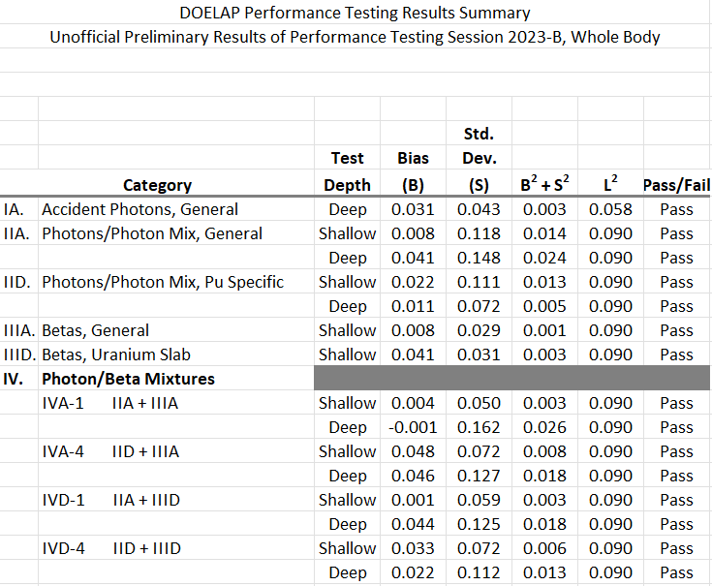
Testing Laboratory
Performance Reports
Notes:
Example of Summary Report showing all categories tested in for this dosimeter type passed

Slide 4
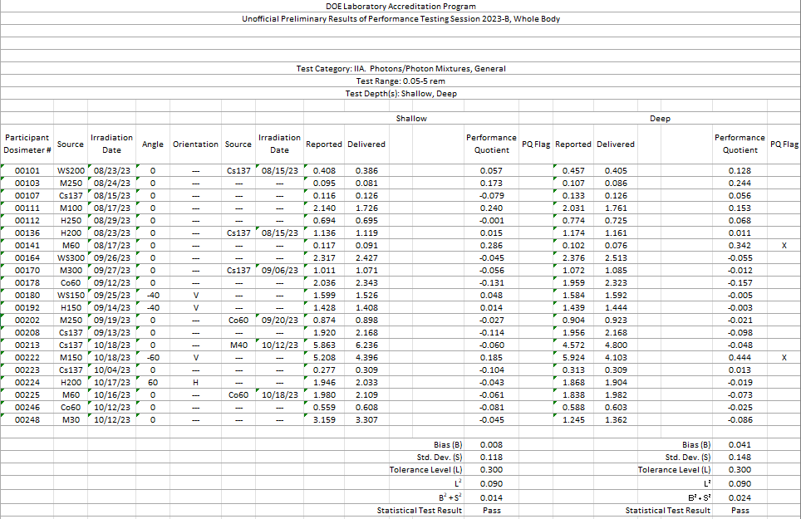
Testing Laboratory
Performance Reports
Notes:
May pass if individual dosimeters fail within the category

Slide 5
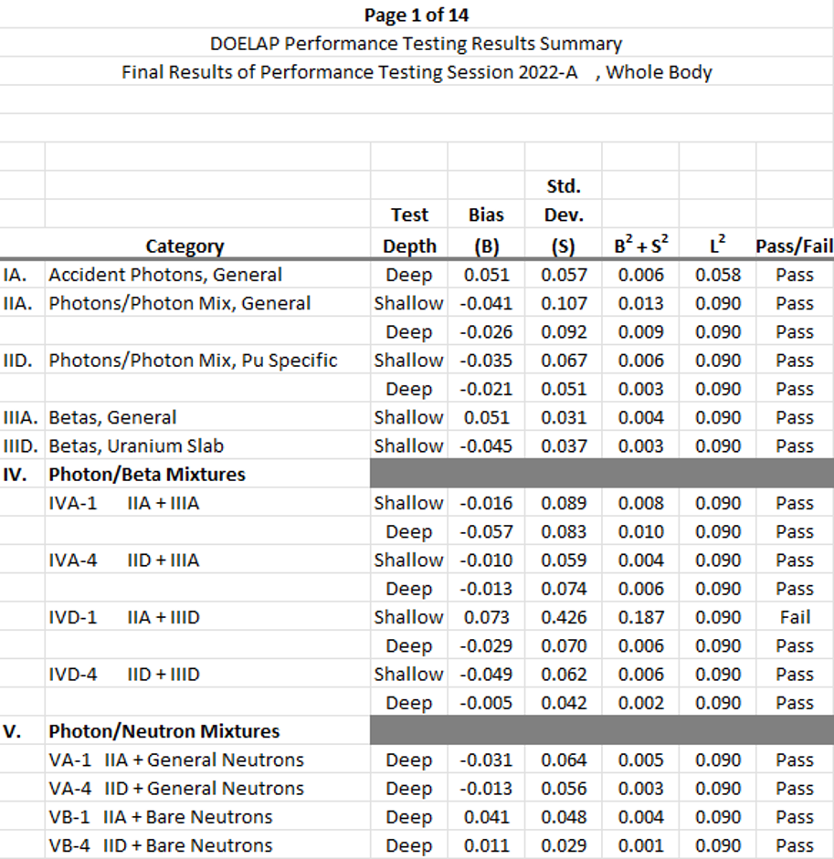
Testing Laboratory
Performance Reports
Notes:
Summary report identifying a failure in category IVD-1.

Slide 6
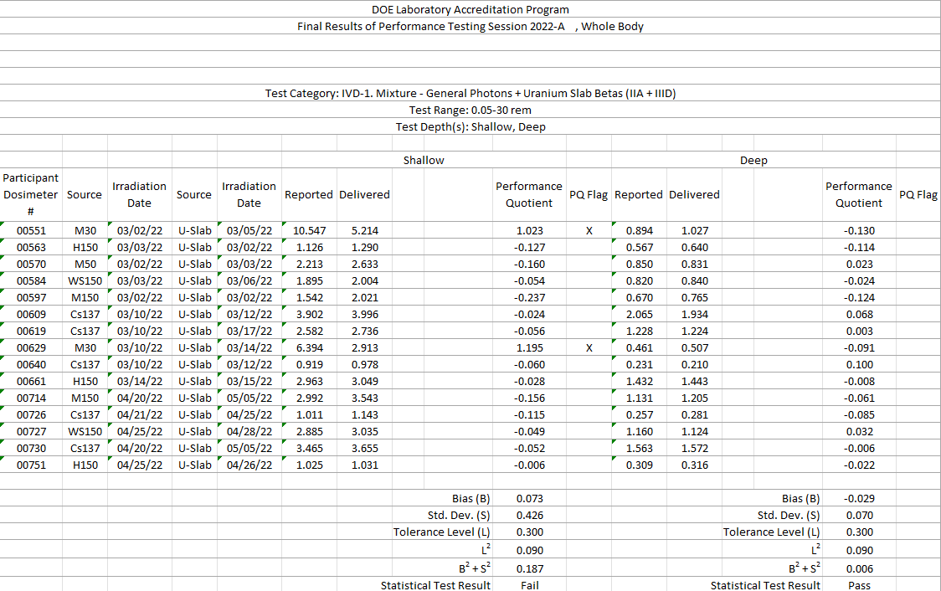
Testing Laboratory
Performance Reports
Notes:
Use the information to identify areas for improvement. In this example, the dosimeter response to low energy x-rays may be investigated.
How did RESL screw up? Quality checks performed before reports are sent.

Slide 7
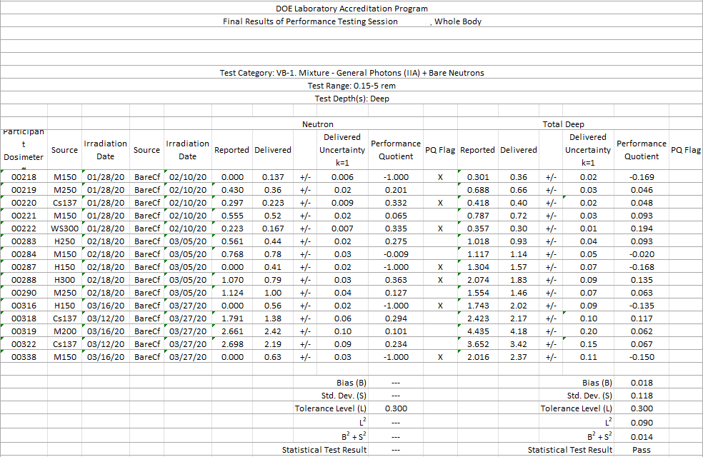
You Passed! Now What?
Notes:
Neutron results are flagged but not deep. Is this an issue a program should investigate?

Slide 8
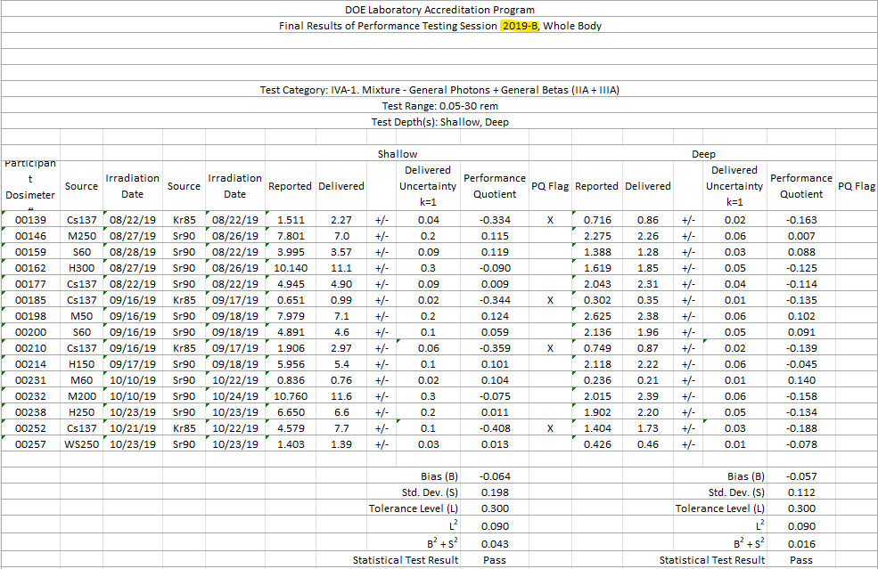
Trending
Notes:
Results show a negative bias outside the tolerance level when reporting krypton in category IVA-1.

Slide 9
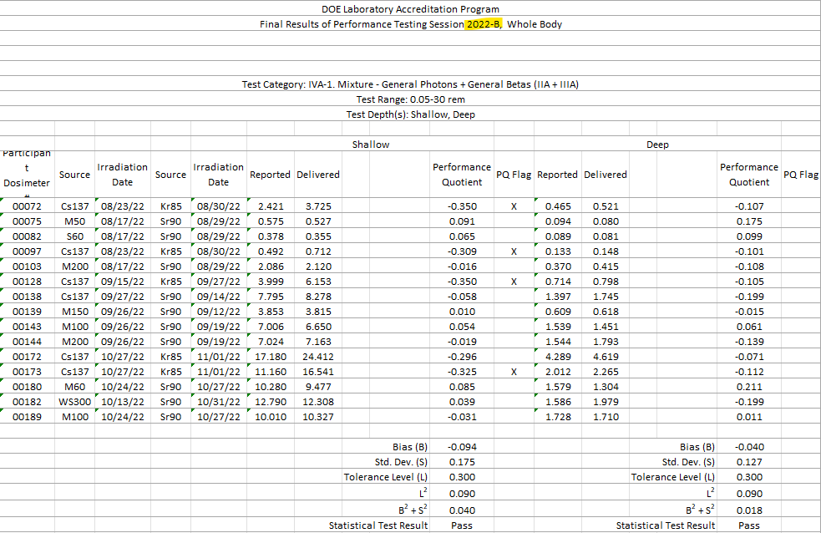
Trending
Notes:
Same trend with krypton as in the 2019 session. This program observed an issue even though the category was passed.

Slide 10
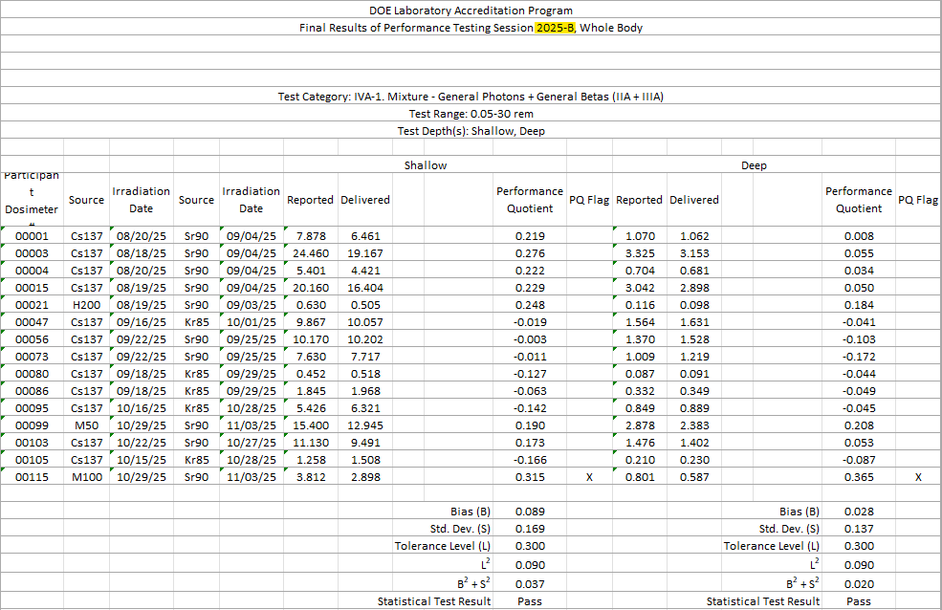
Trending
Notes:
Between the 2022 and 2025 test sessions this program investigated the bias in krypton and applied their own corrective action.

Slide 11
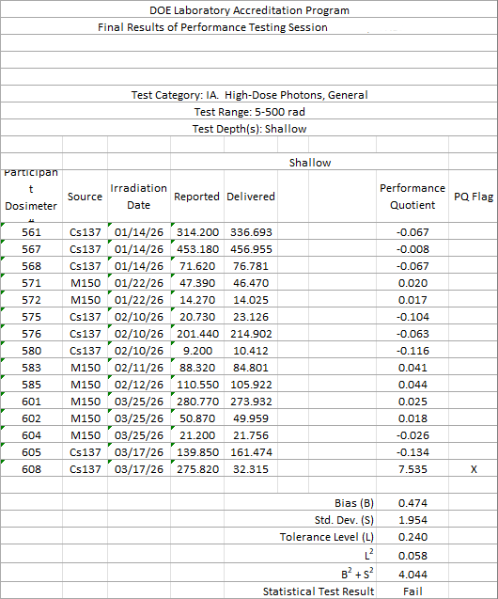
Invite Your Friends
Notes:
Numbers are tricky, sometimes a fat finger wants to push the buttons.
Ask someone who hasn’t been staring at the results for a week to check them; have one person read the results while another types them into the reporting sheet.

Slide 12
Questions

